Slide 1
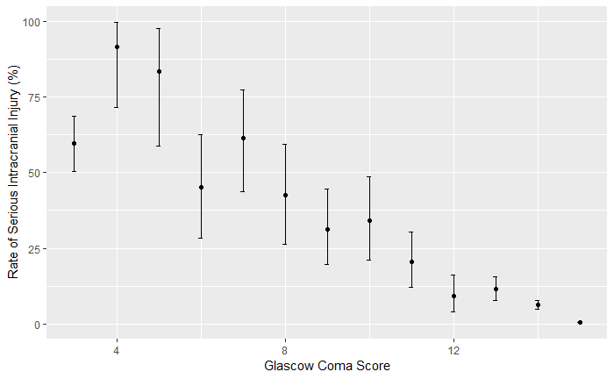
Predictors of Clinically Important Traumatic Brain Injuries Following Minor Blunt Head Trauma in Children: A Failure of the Machine Learning Approach
Callum Rowe,¹ Kathryn Wiesendanger,¹ Conner Polet,² Nathan Kuppermann, MD, MPH,¹ Stephen Aronoff, MD, MBA²
From the Department of Emergency Medicine¹, University of California, Davis School of Medicine, Sacramento, CA and
the Department of Pediatrics², Lewis Katz School of Medicine at Temple University, Philadelphia, PA
BACKGROUND
METHODS
RESULTS
CONCLUSIONS
The Pediatric Emergency Care Applied Research Network (PECARN) conducted a study of ~42,000 children with minor blunt head trauma and developed and validated a clinical prediction rule to identify those at low risk of clinically-important traumatic brain injuries (ciTBIs) .¹
Prior studies have relied on traditional multivariable statistical methods,¹⁻² but more recent research regarding prediction rules has used machine learning (ML).³⁻⁶
In a previous study, investigators created a ML algorithm analyzing the PECARN dataset using a single decision tree that fits all nodes simultaneously, a complicated model at risk of over fitting.⁶
In this study, we created multiple algorithms (see Table 2) using ML for classification of children at risk for ciTBIs via the PECARN head trauma public use dataset. The model predictions were statistically compared to no information rates, the error rate when the input and output are independent.
Figure 1. Flowchart
For those patients without clinical evidence of skull fractures, the rates of ciTBI for GCS 14 and GCS 15 were significantly different (χ² = 604.02, p <.0001) and were modeled separately.
ML algorithms were unable to produce a superior prediction model for ciTBI among children with blunt head trauma when compared to PECARN’s head injury prediction rule.
GCS was the only important predictor identified by ML algorithms.
Complete Data Set
N = 43,399; ciTBI = 763 (1.76%)
ciTBI status unknown
N = 20
Table 4. Comparison of the no information model and ML algorithms as predictors of ciTBI in children with no clinical evidence of skull fractures and GCS scores of 14
N = 43,379;
ciTBI = 743 (1.76%)
Model | True Negative | False Negative | ciTBI Rate | p value
No information | 392 | 26 | 0.062 | 1
Logistic Regression | 389 | 26 | 0.063 | 1
CART | 389 | 26 | 0.063 | 1
Random Forest | 389 | 26 | 0.063 | 1
Generalized Boosted Model | 392 | 26 | 0.062 | 1
ciTBI = clinically-important Traumatic Brain Injury, CART = Classification and Regression Trees
GCS = 14,15
N = 41, 487
Clinically Apparent Skull Fracture
N = 381;
ciTBI = 67(14.9%)
REFERENCES
[1] Kuppermann N, Holmes JF, Dayan PS, Hoyle JD, Jr., Atabaki SM, Holubkov R, et al. Identification of children at very low risk of clinically-important brain injuries after head trauma: a prospective cohort study. Lancet. 2009;374:1160-70.
[2] Maguire JL, Boutis K, Uleryk EM, Laupacis A, Parkin PC. Should a head-injured child receive a head CT scan? A systematic review of clinical prediction rules. Pediatrics. 2009;124:e145-54.
[3] Goto T, Camargo CA, Jr., Faridi MK, Freishtat RJ, Hasegawa K. Machine Learning-Based Prediction of Clinical Outcomes for Children During Emergency Department Triage. JAMA Netw Open. 2019;2:e186937.
[4] Jovic S, Miljkovic M, Ivanovic M, Saranovic M, Arsic M. Prostate Cancer Probability Prediction By Machine Learning Technique. Cancer Invest. 2017;35:647-51.
[5] Kim SK, Yoo TK, Oh E, Kim DW. Osteoporosis risk prediction using machine learning and conventional methods. Conf Proc IEEE Eng Med Biol Soc. 2013;2013:188-91.
[6] Bertsimas D, Dunn J, Steele DW, Trikalinos TA, Wang Y. Comparison of Machine Learning Optimal Classification Trees With the Pediatric Emergency Care Applied Research Network Head Trauma Decision Rules. JAMA Pediatr. 2019.
GCS = 14
N = 1230; ciTBI = 77(6.2%)
GCS = 15
N = 39,876; ciTBI = 192(.48%)
Table 5. Comparison of the no information model and ML algorithms as predictors of ciTBI, in children with no clinical evidence of skull fractures and GCS scores of 15
OBJECTIVES
The PECARN public use data set included 43,399 patients <18 years-old with blunt head trauma at one of 25 pediatric Emergency Departments between 6/2004 and 9/2006.
Clinical evidence of skull fractures were highly predictive of ciTBI and were not further evaluated.
We divided the dataset into derivation (training) and validation (testing) subsets; four ML algorithms were optimized using the training dataset. Fitted models used the validation set to predict ciTBI and these predictions were compared statistically to the no information rate.
Model | True Negative | False Negative | ciTBI Rate | p value
No information | 13492 | 65 | 0.00479 | 1
Logistic Regression | 13492 | 65 | 0.00479 | 1
CART | 13492 | 65 | 0.00479 | 1
Random Forest | 13492 | 65 | 0.00479 | 1
Generalized Boosted Model | 13492 | 65 | 0.00479 | 1
ciTBI = clinically-important Traumatic Brain Injury, CART = Classification and Regression Trees
To develop a clinical prediction tool using ML, for identifying children with ciTBIs after blunt head trauma that has superior prediction than the rules developed in PECARN’s 2009 study.
METHODS
Table 1. PECARN Head Injury Prediction Variables
The PECARN head injury rule states that if a child, having suffered blunt force head trauma, has none of these clinical features they are considered very low-risk for a ciTBI.¹
None of the ML models was superior to the no information rate.
 | Age < 2 Years | Age ≥ 2 Years
1. | Severe MOI* | Severe MOI*
2. | History of LOC ≥ 5 seconds | History of any LOC
3. | GCS < 15 or AMS | History of emesis
4. | Palpable/suspected skull fracture | GCS < 15 or AMS
5. | Tempero/parietal/occipital scalp hematoma | Severe headache
6. | Acting abnormally per parent | Signs of basilar skull fracture
MOI = Mechanism of Injury; LOC = Loss of Consciousness; GCS = Glasgow Coma Score; AMS = Altered Mental Status; PECARN = Pediatric Emergency Care Applied Research Network *Severe mechanism defined by motor vehicle crash with patient ejection, death of another passenger, or rollover; pedestrian or bicyclist without helmet struck by a motorized vehicle; falls > 3 feet for those younger than 2 years; falls > 5 feet for those older than 2 years; or head struck by a high-impact object.
Table 2. ML Algorithms Utilized and their Functions
Figure 2. Relationship between ciTBI rates and GCS in children with no clinical evidence of skull fracture
Algorithm | Function
Linear Regression (LR) | Provides a Linear Classifier
Classification and Regression Tree (CART) | Provides an optimized, single descision tree
Random Forest | An ensemble tree algorithm that tests a random selection of predictive variables for each node of multiple trees
Generalized Boosted Machine (GBM) | An ensemble tree algorithm that improves each iteration based on the prior tree
ACKNOWLEDGEMENTS
This analysis was preformed using the Identification of Children at Very Low Risk of Clinically Important Brain Injuries After Head Trauma: A Prospective Cohort Study public use dataset obtained from the PECARN Data Coordinating Center, University of Utah School of Medicine, and does not necessarily reflect the opinions or views of the study investigators, the Health Resources Services Administration (HRSA), Maternal Child Health Bureau (MCHB) or Emergency Medical Services for Children (EMSC). PECARN is funded by the HRSA/MCHB/EMSC.
Rate of ciTBI (%)
00
75
50
25
0
3 4 5 6 7 8 9 10 11 12 13 14 15
Glasgow Coma Score

