Slide 1

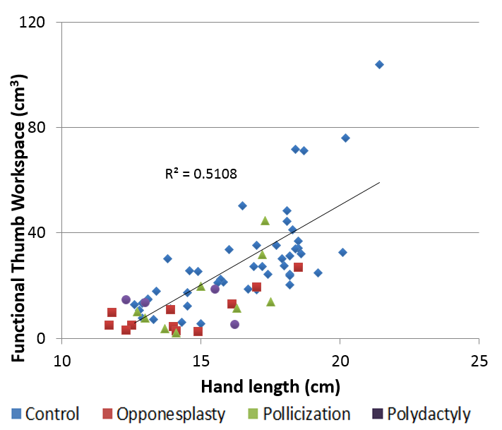
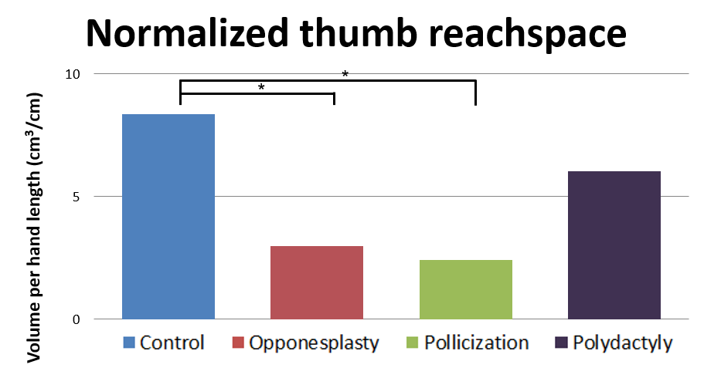
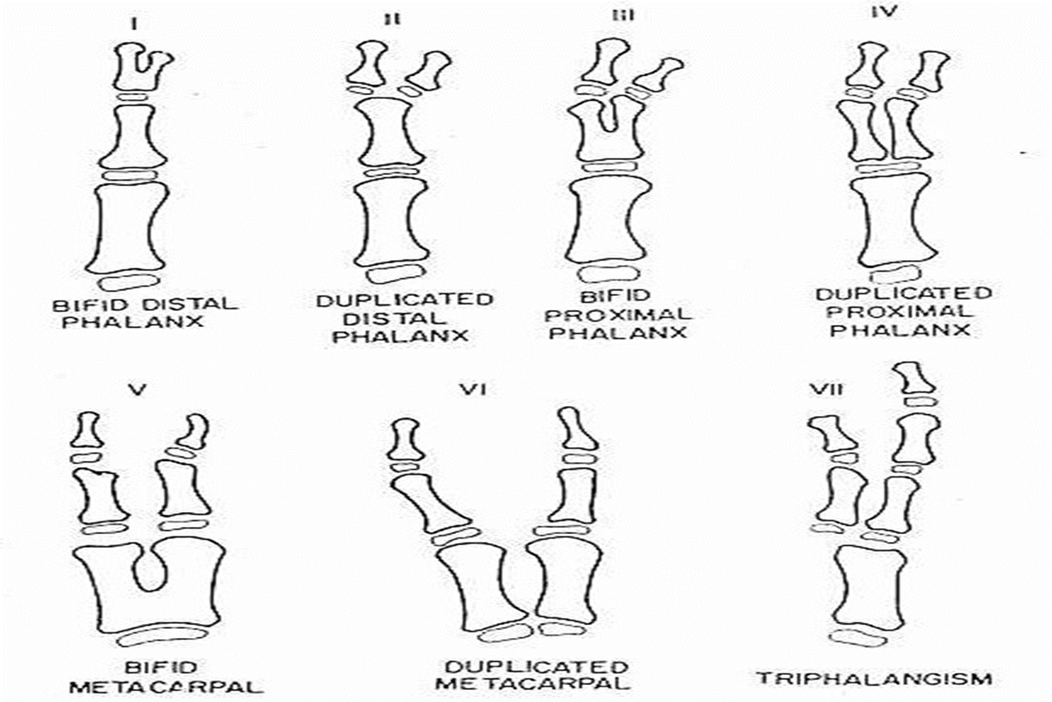
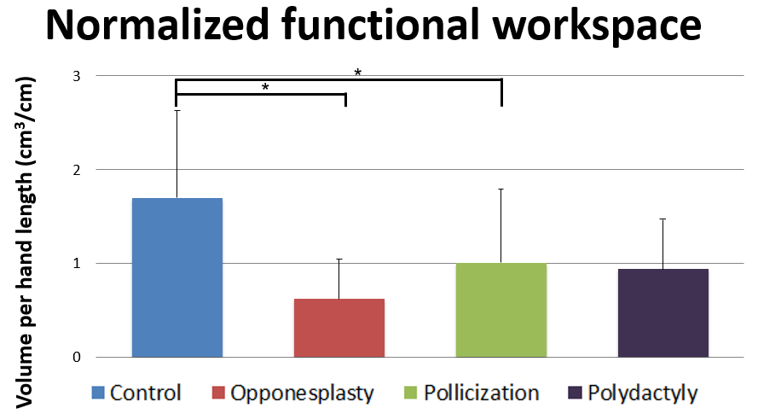
Kinematic Analysis of Functional Workspace for Children with Thumb Polydactyly
Alisha A. Othieno, Patrick F. Curran MD, Michelle A. James MD
Department of Orthopaedic Surgery, University of California, Davis; Shriners Hospitals for Children, Northern California
INTRODUCTION
METHODS & MATERIALS
RESULTS
Preaxial polydactyly, or duplication of the thumb, is classified based on the level of duplication (Figure 1).
Different procedures are indicated depending on the level of duplication and the extent of deficiency
Surgery is usually performed in order to improve appearance and prehension⁵
Cross-sectional, observational study
Control, pollicization, and opponensplasty data from previous studies were also used to compare groups³
Subjects recruited from SHCNC Hand Clinic and local community
      50 controls (11.2y; 25F; 26DH)
      13 opponensplasty (8.8y; 5F; 5DH)
      12 pollicizations (10.7y; 7F; 3DH)
      4 polydactyly (8.5y; 1F; 2DH)
Primary Outcome Measures
  Thumb functional workspace
Secondary Outcome Measures
  Pediatric hand function questionnaire (PODCI)
  Hand morphology and ROM measured
  Pediatric hand function tests (Kapandji Opposition scale, Functional Dexterity Test, Jebsen-Taylor Hand Function Test & Blocks in Box Test)
  Motion analysis testing: 12 markers on bony landmarks of the thumb, hand and fingertips for range of motion tasks and functional tasks (Figure 2)
Figure 3: Total thumb reach space as a function of hand size in normal (blue), opponensplasty (red), pollicization (green), and polydactyly (purple) patients.
Figure 4: Normalized (a) thumb and (b) functional workspace of the control (blue), opponensplasty (red), pollicization (green), and polydactyly (purple) groups.
DISCUSSION
This study presents application kinematic model of the thumb, finger and hand for measurement of thumb ROM and functional workspace in children with congenital thumb polydactyly
Functional workspace correlated with hand length in control patients
The total reachspace and functional workspace was highest in the controls and polydactyly reconstruction groups, compared with the pollicization and opponensplasty groups
Normalized functional workspace was statistically significantly larger for the control group compared to the opponensplasty, and pollicization groups.
Subject to Type II error due to low power at analysis
Further investigation will evaluate the impact on functional workspace of the different surgical techniques used for polydactyly thumb reconstruction
Previously, a 3D kinematic model has been developed to test patients with normal hand function, pollicization, and opponensplasty^{1,3}
However, studies have yet to directly quantify the ability of the fingers and thumb to interact in space, in patients after thumb polydactyly reconstruction
Figure 2: (a) Markers on control participant. (b) Marker placement and local coordinate system. (1-3) thumb metacarpal; (4) thumb proximal phalanx ; (5) thumb distal phalanx; (6-9) finger tip digits 2-5; (10-11) 2nd MC; (12) 3rd MC
OBJECTIVES
DATA ANALYSIS
To use the three dimensional motions analysis (3DMA) technique to discern differences between the functional workspace of normal thumbs (n=50) and reconstructed thumbs
To measure functional workspace with congenitally deficient thumbs post-polydactyly reconstruction that will correlate with other accepted function and appearance metrics for these populations (n=20)
To compare the differences in functional workspace of those patients with the functional workspace of patients with congenitally deficient thumbs post-opponensplasty (n=20) and post-pollicization (n=20)
Active joint ROM calculated as distal segment relative to proximal segment in local joint coordinate system calculated in MATLAB
Functional workspace of the hand determined as all points in space that fingertips and thumb tips can touch calculated in MATLAB
Data from range of motion, strength, and functional tests compared to age-, sex-, and hand-matched historical normal subjects
Statistical analysis by linear regression & paired t-test (p < 0.05)
REFERENCES
Bauer AS, Netto AP, James MA. Thumb Hypoplasia Occurring in Patients with Pre-axial Polydactyly. J Hand Surg Am. 2017. In press.
Bednar MS, Light TR, Bindra R. Chapter 9. Hand Surgery. In: Skinner HB, McMahon PJ. eds. Current Diagnosis & Treatment in Orthopedics, 5e New York, NY: McGraw-Hill; 2014. Accessed January 2, 2018.
Curran PF, Bagley A, Sison-Williamson M, James MA. A three-dimensional model for analysis of functional thumb motion in normal adults. In revisions to the Journal of Clinical Biomechanics. 2013.
Goldfarb CA, Patterson JM, Maender A, Manske PR. Thumb size and appearance following reconstruction of radial polydactyly. J Hand Surg Am. 2008;33(8):1348-53.
Wall LB, Goldfarb CA. Reconstruction for type IV radial polydactyly. J Hand Surg Am. 2015;40:1873-1876.
ACKNOWLEDGEMENTS
We thank the administrators, clinicians, health care workers, information technology staff, and our patients for their continued support. Our success is a result of their hard work and dedication to improving the health of our patients by providing them with the highest quality care.

