Slide 1
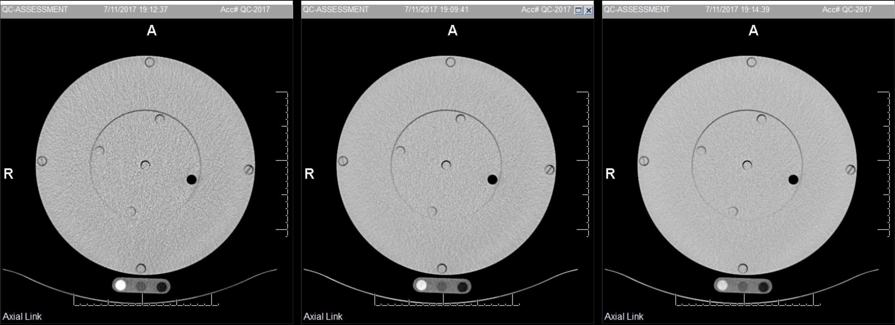
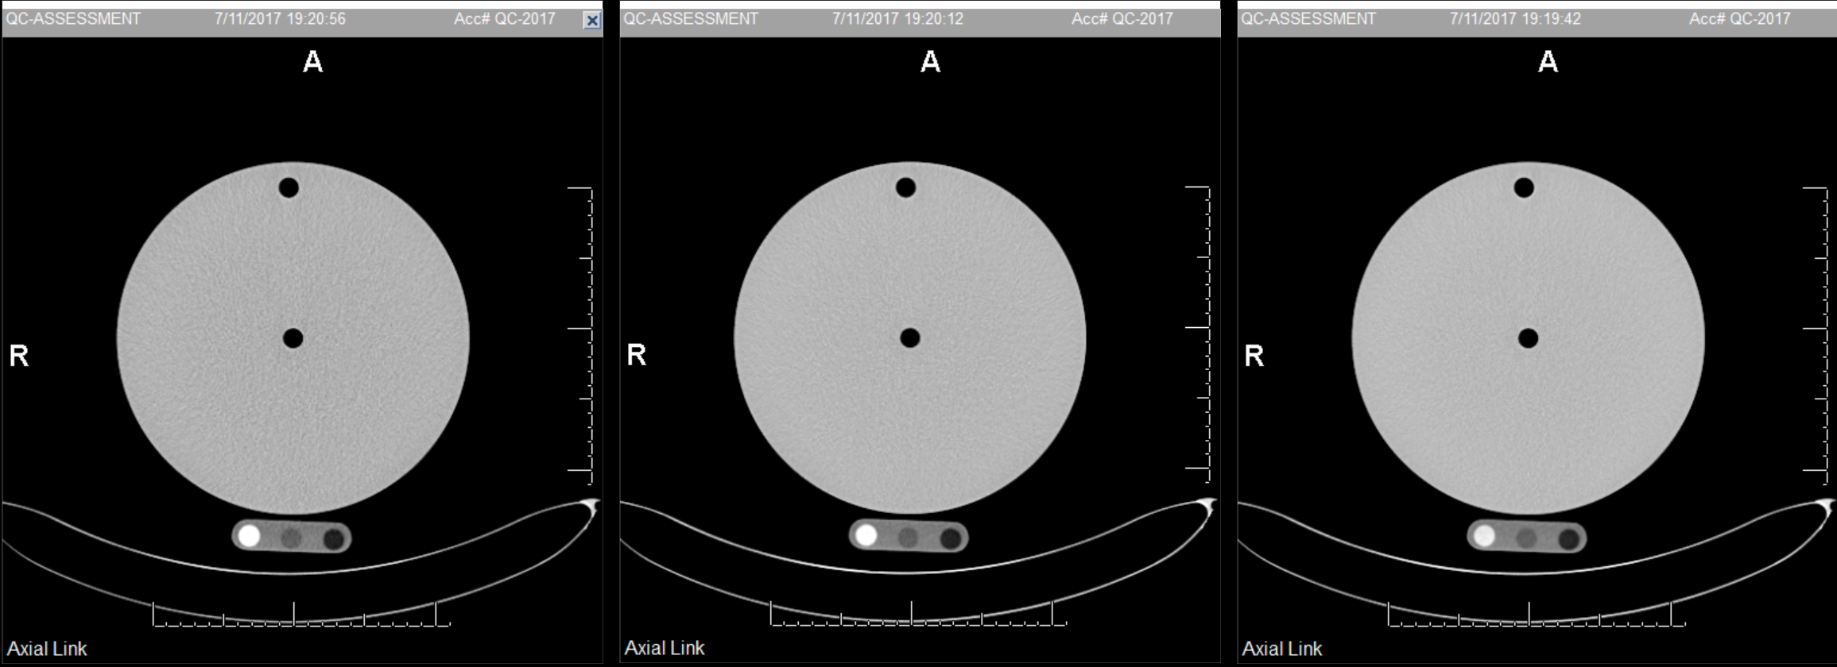
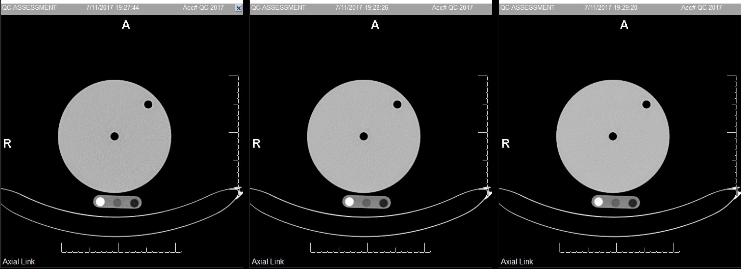
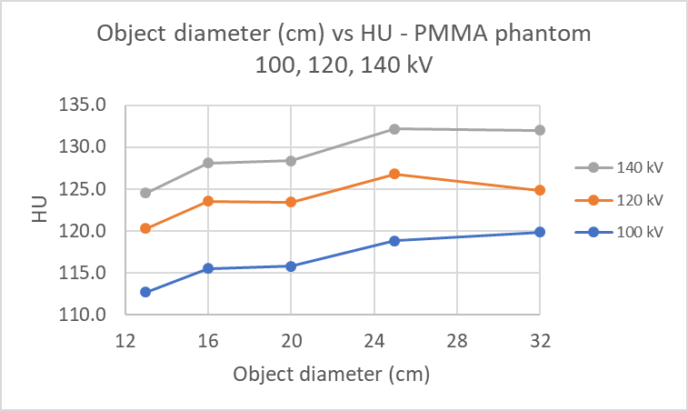
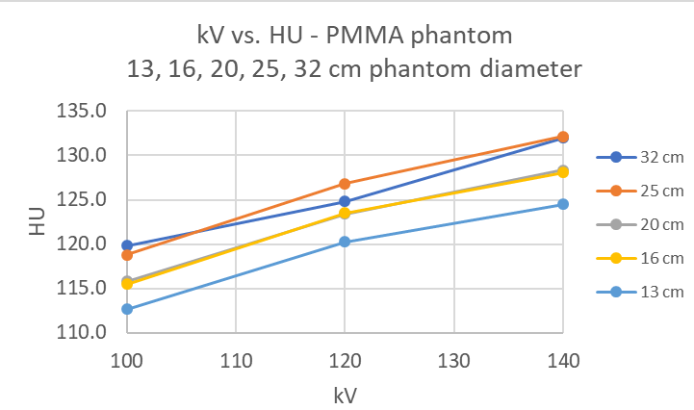
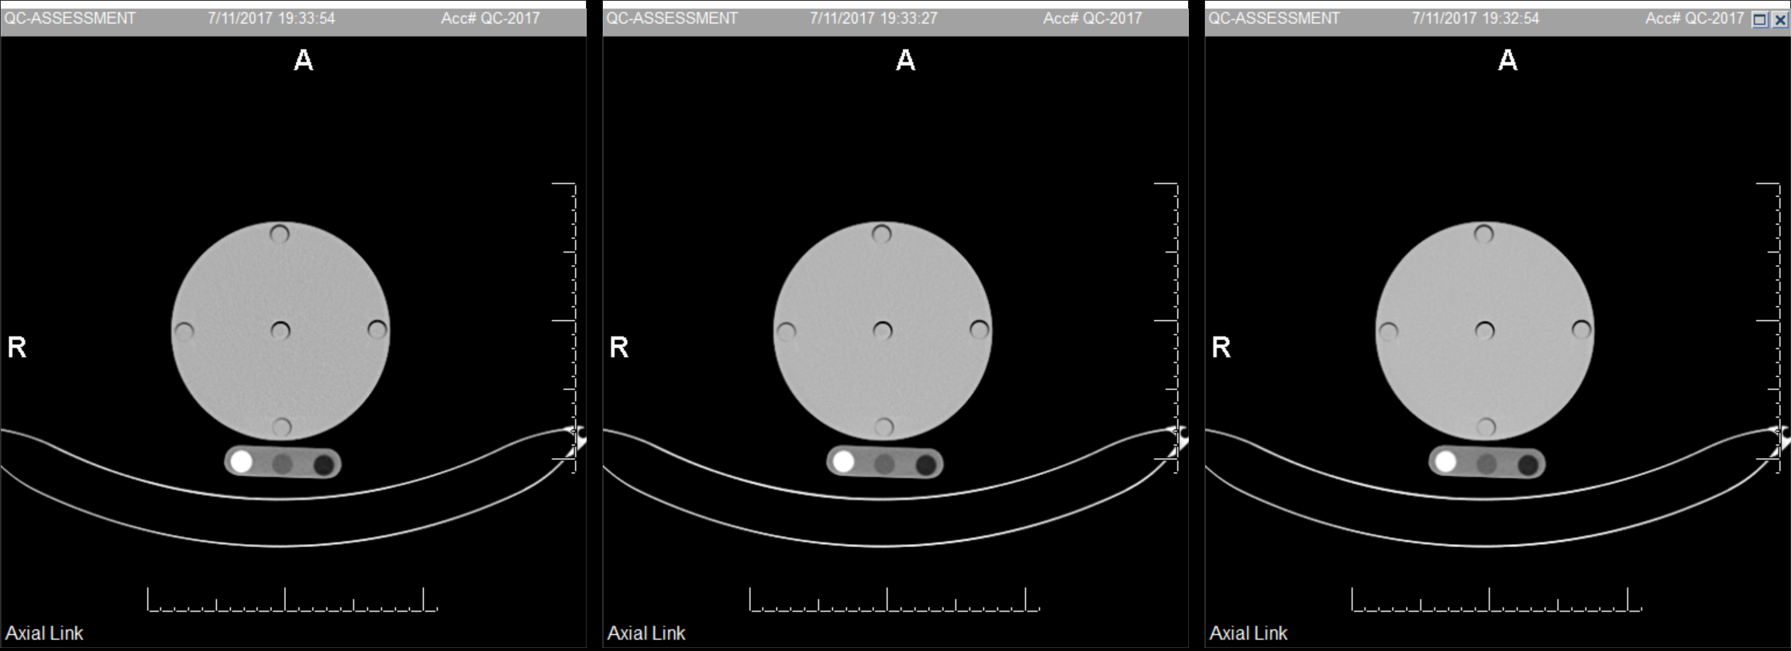
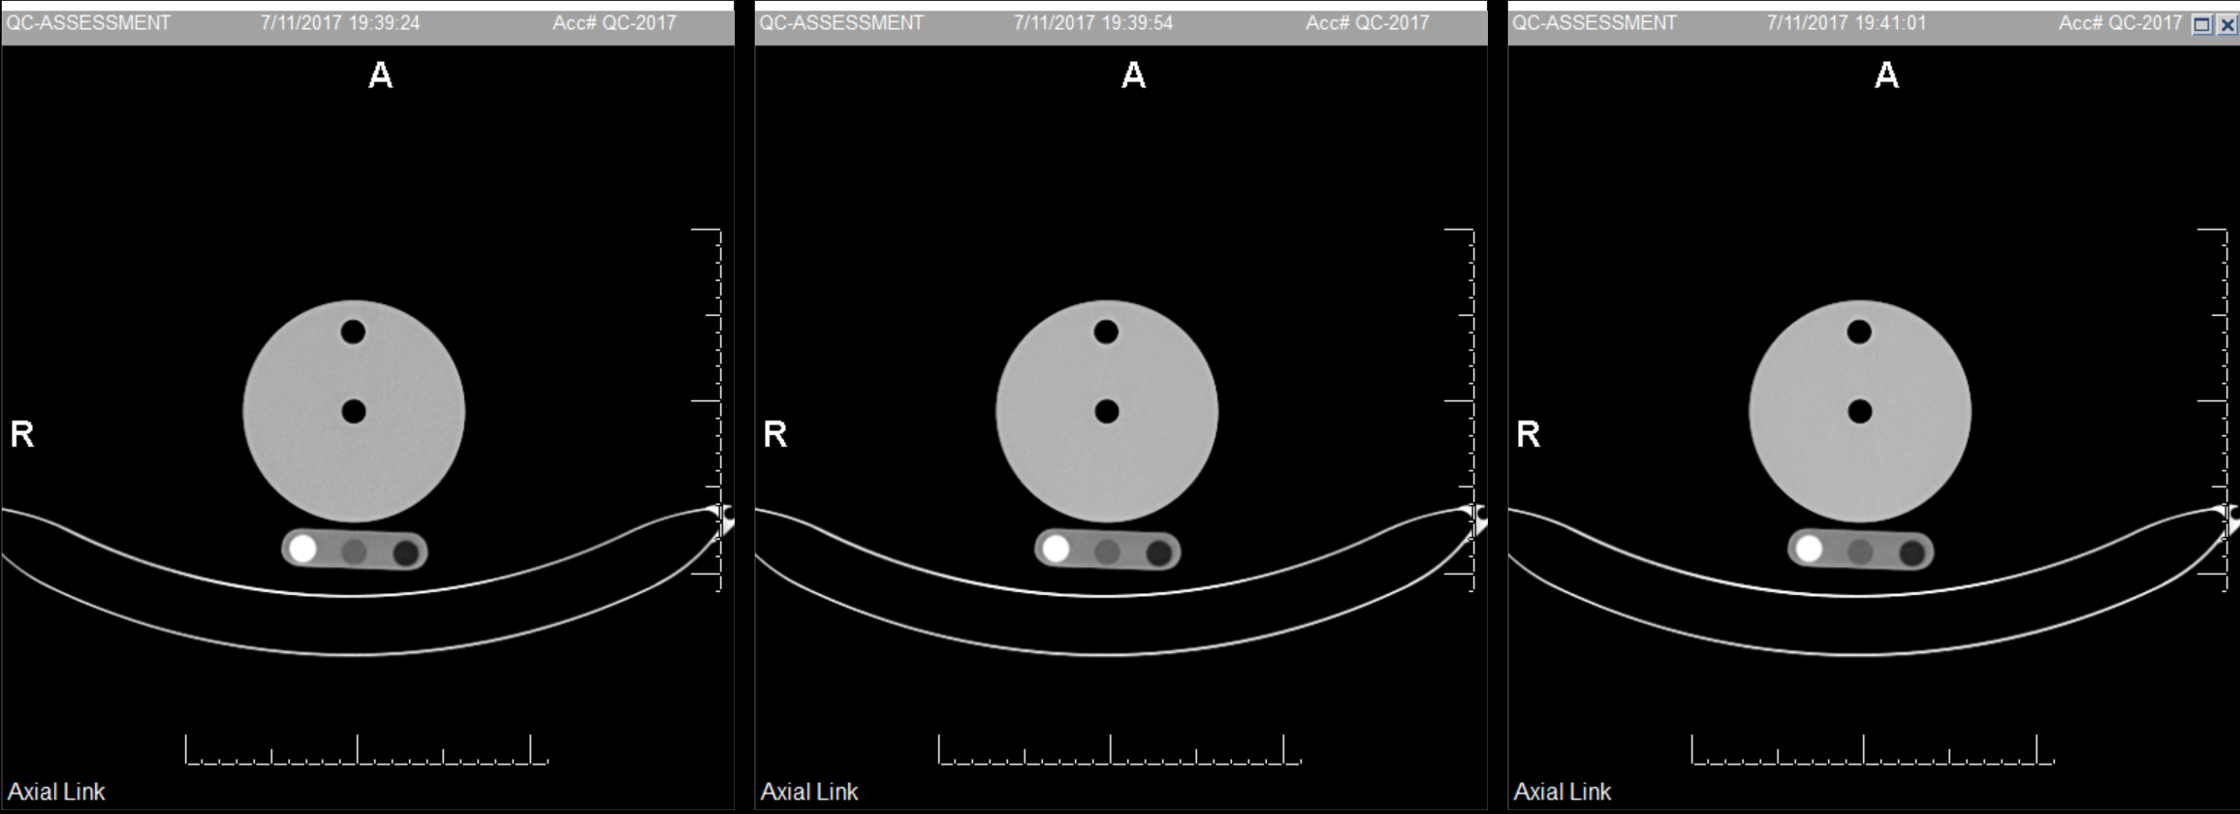
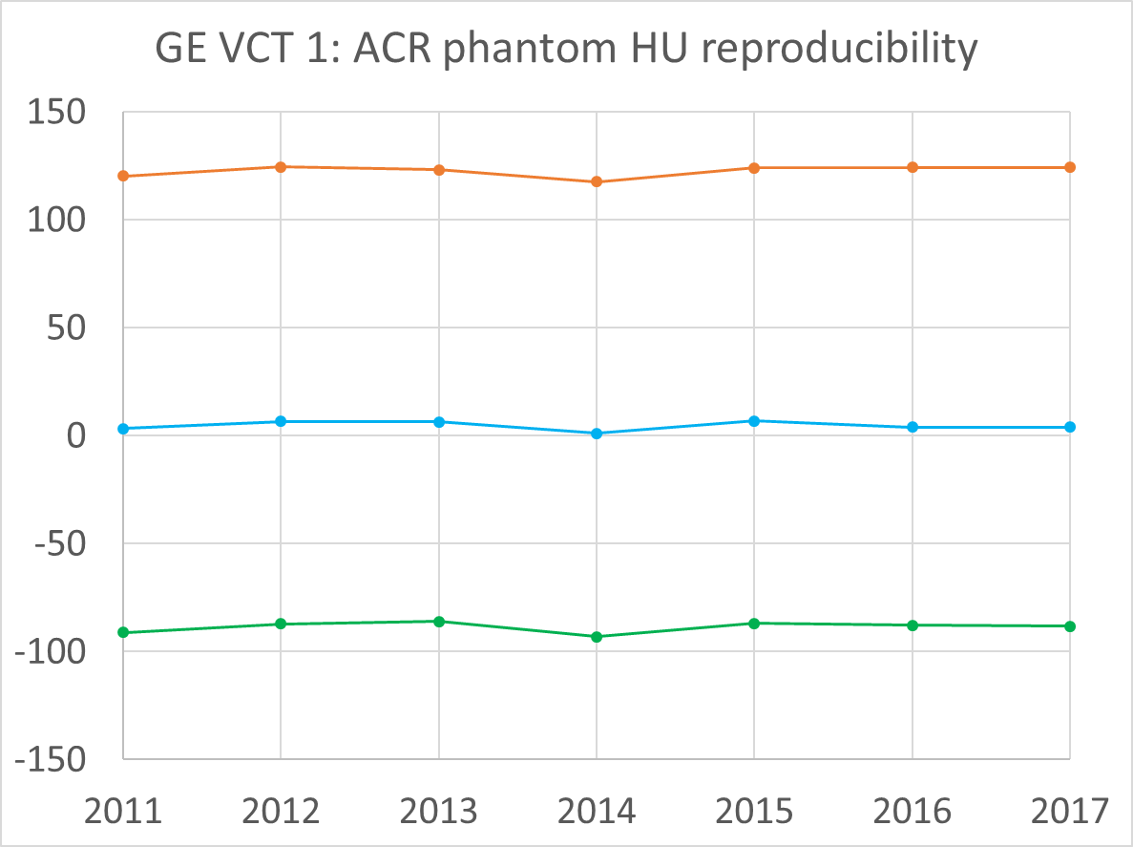
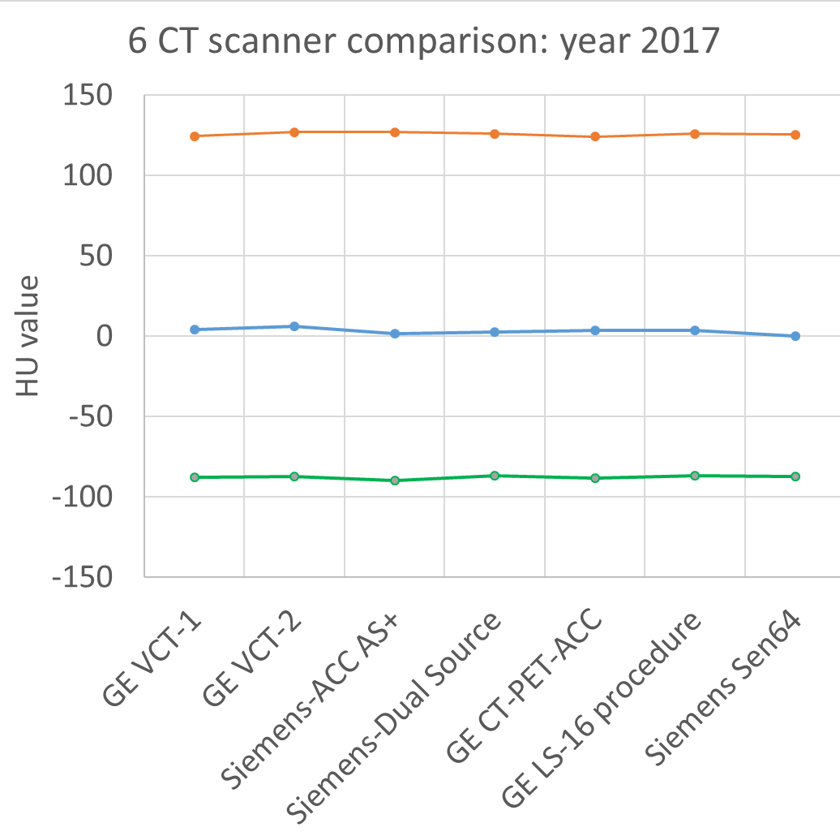
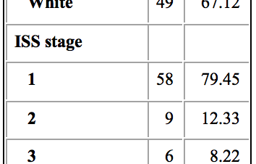
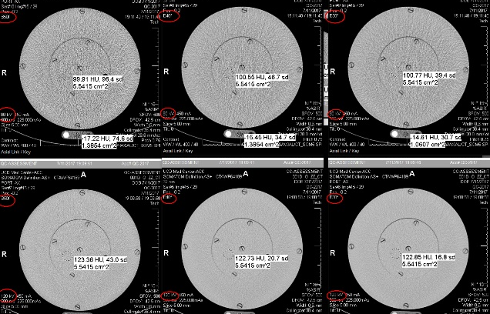
Computed Tomography (CT) Measurements of Attenuation:
Influence of Patient Size and Tube Potential
¹Robert D. Boutin, MD, ²Leon Lenchik, MD, ³Behrang Amini, MD, PhD, ¹Sean P. Boyle, BS, ¹J. Anthony Seibert, PhD, and ¹John M. Boone, PhD
¹University of California Davis School of Medicine; ²Wake Forest Baptist Medical Center; ³M.D. Anderson Cancer Center
INTRODUCTION
RESULTS
DISCUSSION
Diagnostic images are more than pictures; they contain quantitative data that are largely hidden to viewers. These data can be “mined” to add value to existing imaging examinations, and this paradigm shift involving “radiomics” has been identified as “the next frontier in clinical decision making” [1].
Even simple CT-derived metrics – such as attenuation (measured in Hounsfield Units, HU) – for muscle (myosteatosis), fat (obesity), and bone (osteoporosis) phenotypes are associated with clinical outcomes and can supplement clinical decision support [2-4].
CT technique can substantially influence HU numbers, and yet often are not reported in the literature [5]. Besides intravenous contrast material, other factors expected to influence HU values are patient size (diameter), CT tube voltage (kV), and CT scanner calibration.
100 kV
D = 32 cm
120 kV
D = 32 cm
140 kV
D = 32 cm
Diameter and kV. CT phantoms of different 5 diameters scanned at 3 different kVs and resultant HU measurements are shown in Figure 1.
HU values showed phantom size dependencies over the 5 diameters, with 92%, 55%, and 82% of the variance described by phantom diameter for the 100 kV, 120 kV, and 140 kV data sets, respectively (Fig. 2A).
While the trend in HU values was significant (p<0.05), the % CV across the five diameters was only 2.4%, 1.9%, and 2.5% for the 100, 120, and 140 kV datasets, respectively.
Eliminating the two smaller diameter phantoms to reflect more realistic adult abdomen diameters (20-32 cm), the CVs were reduced to 1.8%, 1.4%, and 1.6%, respectively.
For each phantom diameter, varying the tube potential between 100 and 140 kV resulted in a significant (p<0.05) change in measured HU values, with the average CV increased to 5.1% (Fig. 2B).
Our study highlights that CT HU numbers could be affected by patient and technical factors, including patient diameter (e.g., with cachexia vs. obesity) and kV (e.g., with 120 kV on routine CT vs. 140 kV on PET/CT).
With greater object size, lower energy photons are more heavily attenuated than higher energy photons, and therefore the effective energy “seen” by the CT detectors is higher; this results in a spurious change in HU values from the periphery to center of the object.
Numerous other factors can cause deviation in HU values, even if CT scanners are properly calibrated, including: intravenous contrast material, patient position in the scanner, reconstruction kernel, and scanner model [5-8].
121.7, 20.2
120.6, 20.4
126.7, 15.2
122.3, 14.9
133.6, 12.4
133.2, 10.5
117.2, (27.8)
125.4, (20.1)
129.2, (15.3)
100 kV
D = 25 cm
120 kV
D = 25 cm
140 kV
D = 25 cm
120.9, 10.6
115.8, (11.7)
119.6, 11.0
128.3, 8.2
124.8, (9.4)
127.4, 7.1
134.0, 6.1
128.9, (7.7)
133.6, 6.1
CONCLUSION
100 kV
D = 20 cm
120 kV
D = 20 cm
140 kV
D = 20 cm
HU values are influenced by object diameter (patient size) and CT tube voltage, which may affect quantitative evaluation of muscle, bone, and fat.
For clinical CT parameters, HU measurements with better than 2% precision can be achieved across a range of patient diameters.
In our experience, clinical CT scanners were calibrated within 5 HU.
Variation in CT tube voltage results in significantly degraded reproducibility that should be considered when obtaining CT HU measures in clinical trials using muscle, bone, or fat phenotypes.
OBJECTIVES
116.5, 6.1
124.3, 5.0
128.9, 4.0
The purpose of this study was to evaluate the precision of CT HU measurements across different object diameters (as a surrogate for patient size), different kVs, and CT scanner calibration.
115.2, (7.3)
115.7, 6.0
123.0, (5.5)
123.0, 5.1
128.2, (5.0)
128.0, 4.0
A
B
METHODS
100 kV
D = 16 cm
120 kV
D = 16 cm
140 kV
D = 16 cm
Diameter and kV. To study the influence of object diameter (body size) on CT HU measurements, 5 cylindrical polymethyl methacrylate (PMMA) plastic phantoms were scanned over a range of 5 diameters (13, 16, 20, 25, and 32 cm). To study the influence of kV on HU measurements, each phantom was scanned over a range of 3 tube potentials (100, 120, and 140 kV).
All scanning was performed on a multidetector array CT scanner (Siemens, Definition 128 AS+) at 225 mAs, and images were reconstructed to 5-mm thickness using a B40 reconstruction kernel. The attenuation (HU) was recorded at three locations and averaged.
The coefficient of variation (CV) for phantom attenuation was calculated and compared as a function of the diameter of the scanned object and the kV.
CT Scanner Calibration. To study the potential influence of scanner calibration, we extracted data from annual physics reports for the standard ACR phantom over 6 years on one scanner (General Electric, VCT) and compared HU values for 7 CT scanners at our institution.
Figure 2. The % CV was smaller for changes object diameter (A) than for changes in kV (B).
115.4, 4.2
115.9, 4.2
123.1, 3.5
123.7, 3.2
127.9, 2.8
128.0, 2.7
115.2, (4.6)
123.7, (3.7)
128.3, (3.4)
CT Scanner Calibration. Data from the ACR phantom (20 cm diameter) on a single CT scanner shows HU values for PMMA (approximating trabecular bone attenuation), water, and polyethylene (approximating fat attenuation) were stable to < 5 HU over 6 years (Fig. 3). Reproducibility of 7 different CT scanners also was stable to within 5 HU.
REFERENCES
100 kV
D = 13 cm
120 kV
D = 13 cm
140 kV
D = 13 cm
1. Gillies RJ, Kinahan PE, Hricak H. Radiomics: Images Are More than Pictures, They Are Data. Radiology. 2016; 278(2):563-77.
2. Boutin RD, Yao L, Canter RJ, Lenchik L. Sarcopenia: Current Concepts and Imaging Implications. AJR Am J Roentgenol. 2015; 205(3):W255-66.
3. Yoo T, Lo WD1, Evans DC. Computed tomography measured psoas density predicts outcomes in trauma. Surgery. 2017; 162(2):377-384.
4. Boutin RD, Bamrungchart S, Bateni CP, Beavers DP, Beavers KM, Meehan JP, Lenchik L. CT of Patients With Hip Fracture: Muscle Size and Attenuation Help Predict Mortality. AJR Am J Roentgenol. 2017; 208:W208-W215.
5. Boutin RD, Kaptuch JM, Bateni CP, Chalfant JS, Yao L. Influence of IV Contrast Administration on CT Measures of Muscle and Bone Attenuation: Implications for Sarcopenia and Osteoporosis Evaluation. AJR Am J Roentgenol. 2016 ;207:1046-1054.
6. Szczykutowicz TP, DuPlissis A, Pickhardt PJ. Variation in CT Number and Image Noise Uniformity According to Patient Positioning in MDCT. AJR Am J Roentgenol. 2017; 208:1064-1072.
7. Garner HW, Paturzo MM, Gaudier G, Pickhardt PJ, Wessell DE. Variation in Attenuation in L1 Trabecular Bone at Different Tube Voltages: Caution Is Warranted When Screening for Osteoporosis With the Use of Opportunistic CT. AJR Am J Roentgenol. 2017; 208:165-170.
8. Lamba R, McGahan JP, Corwin MT, Li CS, Tran T, Seibert JA, Boone JM. CT Hounsfield numbers of soft tissues on unenhanced abdominal CT scans: variability between two different manufacturers' MDCT scanners. AJR Am J Roentgenol. 2014; 203:1013-20.
112.6, 3.4
112.6, (4.0)
112.8, 3.2
120.8, 2.5
120.6, (3.0)
120.1, 2.6
124.2, 2.1
124.7, (3.0)
124.6, 2.4
PMMA
PMMA
Figure 1. CT phantoms of 5 diameters (surrogate for patient size) were scanned at 3 kVs to assess influence on HU. HU mean (and standard deviation) were obtained from regions of interest at the positions indicated. Note:
(1) HU mean modestly decreased with decreasing diameters;
(2) HU mean prominently increased with increasing kV;
(3) HU SD prominently increased with diameter.
Water
Water
Polyethylene
Polyethylene
Figure 3. CT calibration.
HU values were stable within
5 HU over 6 years and 7 scanners.
ACKNOWLEDGEMENTS

