Slide 1
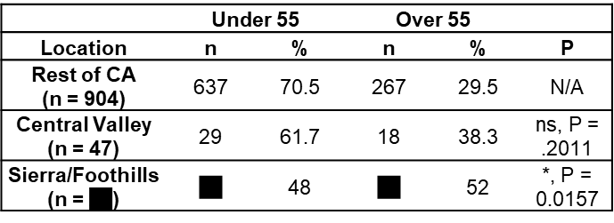
Oligodendroglial tumors in older adult patients in California: clinical characteristics and geographic distribution
Results
Discussion
PFS and OS were decreased in older patients ($≥$ 55 years) in our case series, but this difference was only significant for OS.
Interpreting the results from prior studies on gliomas and oligodendrogliomas together, the most likely factors that modify risk for oligodendroglial tumors can be categorized as specific carcinogenic exposures such as ionizing radiation and water source, genetic factors, and factors related to immune function.
The presence of differences of geographic distribution in older patients in our study combined with the differences in outcomes discussed in previous studies suggests that there may be unique risk factors for oligodendroglial tumors that give rise to tumors in older patients that are biologically distinct.
Based on previously described risk factors for oligodendroglial tumors, candidates for risk factors that modify oligodendroglial tumorigenesis in older adults include differences in genetic predisposition and differences in environmental exposures.
Prior studies have detected differences in water sources and industrial exposures, such as mining and agriculture, between the Sierras/Foothills region and the rest of California.
Michael Sharp, MS2
University of California, Davis
Department of Neurological Surgery
Introduction
Oligodendrogliomas most commonly occur in younger patients aged 20-54. Diagnosis of oligodendrogliomas in older adults is rare, with little known about the risk factors and clinical characteristics of oligodendrogliomas in older adults.
Methods
We present our institutional case series of WHO Grade II/III oligodendroglial (1p/19q-codeleted) tumors and an accompanying analysis of the state-wide incidence of oligodendrogliomas in California extracted from the 1975-2016 Surveillance, Epidemiology, and End Results Program (SEERS) data.
Patient age, county of residence, tumor characteristics, treatment, and clinical course were obtained from the electronic record.
Progression-free survival (PFS) and overall survival (OS) were determined.
Patients were categorized geographically into defined regions, including the Central Valley and Sierras/Foothills groups from our institutional catchment area. Patients aged ≥55 were compared to those <55.
Statistical significance was determined using chi-squared tests, two-tailed t-tests, and log-rank tests
Seventeen patients aged <55 and six patients ≥55 were included in our series. Sierras/Foothills patients were more likely to be aged ≥55 than Central Valley patients, with a trend towards significance (50% vs. 13%, p = 0.056).
Investigation of SEER data for tumors typically diagnosed from our institution’s catchment area revealed that the proportion of older (≥55 years) patients from the Sierras/Foothills region of CA is significantly higher than rest of the state (OR = 2.58, p = 0.016).
Conclusion
Older patients account for a higher proportion of cases of oligodendroglial tumors in the Sierras/Foothills region compared to the Central Valley and the rest of California. Regional differences in genetic and environmental risk factors may underlie these findings and deserve further study to identify the etiology of tumor formation.
QR code linking to full abstract or manuscript = >>>>>

